Slide 1

DATA2201 - Relational Databases: Course Project
Arianne guedes
Jorge gayer
Robert parker

Slide 2
Case Study - SKS National Bank
SKS is a bank organized into branches and offices. The idea of this case study is to analyze the requirements and assumptions in order to create a database that enables the company to manage its business.

Slide 3
Requirements
BRANCHES
Branches are only available in major cities across Canada
There can be only one branch per city
Branch ID is unique per branch

Slide 4
Requirements
CUSTOMERS
A customer can have only one branch and a branch can have zero or more customers
A customer can have one or more bank accounts, which can be a checking or a savings account
A customer can take out one or more loans, but is not required to
A customer can have a personal banker or loan officer if they wish

Slide 5
Requirements
ACCOUNTS
Each account must have a branch, an account type, a balance, a last accessed date, an interest rate and an overdraft limit
Each account can have at least one customer assigned to it, but multiple are allowed
CITIES
Cities must have a unique name and only one province

Slide 6
Requirements
EMPLOYEES
An employee can be a manager, a loan officer or a banker, but only one
An employee has a set of locations where they work
An employee work location can be a branch or an office but only one
A banker can be assigned to zero or more customers
A loan officer can be assigned to zero or more customers
A manager can manage one or more employees

Slide 7
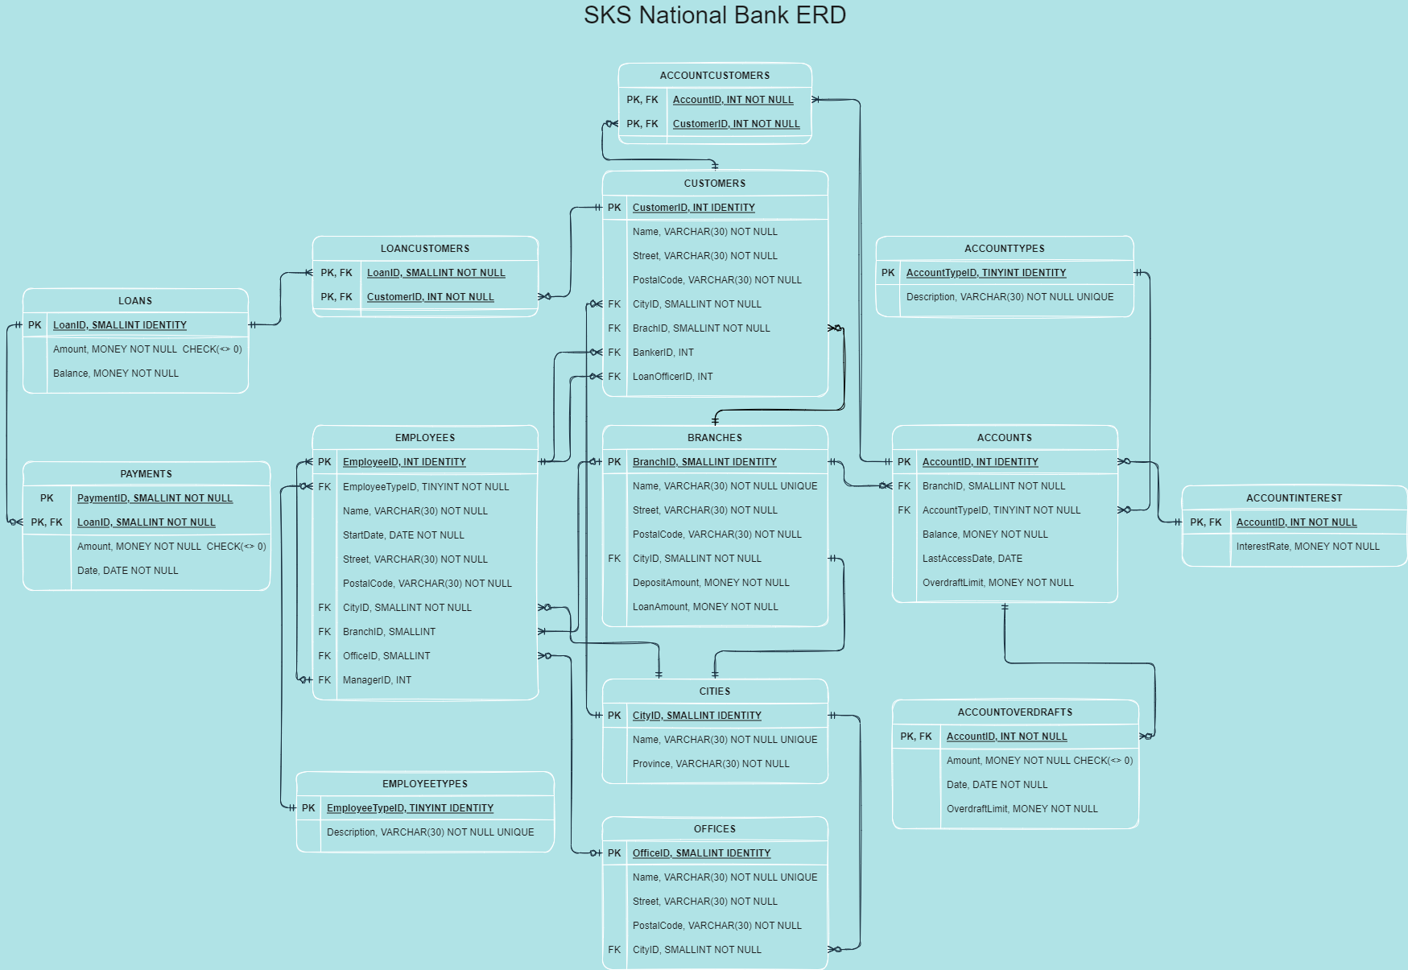
ERD

Slide 8

Any Questions?

Slide 9
Thanks!

